Slide 1
Seasonal Agriculture Performance Analysis
SUBMITTED BY :-
Yash Tolani
College :-
AICTE Student ID :-
Indore Institute of Science and Technology
STU682f3bce808201747925966

Slide 2

PROBLEM STATEMENT
  Context :- Agricultural performance varies significantly across seasons due to changing environmental conditions, irrigation practices, and market prices.
  Core Issue :- Raw agricultural data is complex and fails to directly explain seasonal trends, resource efficiencies, or profitability variations.
  Objective :- Analyze 4,000 farm records across 28 parameters to identify seasonal patterns, yield differences, resource utilization, and economic outcomes.

Slide 3
PROJECT DESCRIPTION
  Scope :- End-to-end Data Analytics project analyzing agricultural performance across Kharif, Rabi, and Zaid seasons in 8 major Indian states.
  Data Processing :- Cleaned missing values (Rainfall, Soil Moisture, Yield) and engineered key performance indicators like Profit Margin %.
  Analytical Approach :- Exploratory Data Analysis (EDA), comparative seasonal profiling, correlation analysis, and statistical hypothesis testing.
  Key Focus Areas :- Crop yield evaluation, water efficiency, disease/pest risk assessment, and financial viability (Revenue vs. Cost).

Slide 4
WHO ARE THE END USERS ?
  Farmers & Agricultural Advisors :- Helps select optimal crop-season combinations to maximize profitability and minimize loss.
  Agricultural Policy Makers :- Supports evidence-based decisions for seasonal resource distribution, fertilizer allocations, and subsidies.
  Irrigation & Water Resource Managers :- Assists in optimizing irrigation methods (Drip vs. Flood/Sprinkler) during water-scarce seasons like Zaid.
  Agri-Fintech & Supply Chain Analysts :- Aids in risk modeling, disease risk tracking, and market price forecasting.

Slide 5

TECHNOLOGY USED
  Programming Language :- Python 3 – Core language for data processing, EDA, and statistical modeling.
  Data Manipulation :- Pandas & NumPy – Data cleaning (120 missing values), grouping, and feature engineering (Profit Margin %).
  Data Visualization: Matplotlib & Seaborn – Generating Heatmaps, Seasonal Profit Boxplots, and Bar Charts.
  Statistical Analysis: SciPy (scipy.stats) – One-Way ANOVA testing (p-value = 1.71 × 10⁻¹⁵) and Pearson correlation analysis.
  Environment: Google Colab / Jupyter Notebook – Interactive IDE for code execution and visual reporting.
Notes:
5

Slide 6
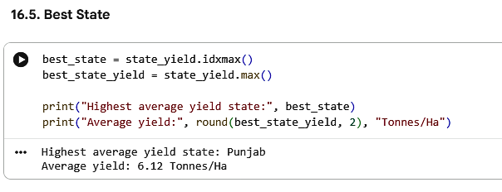
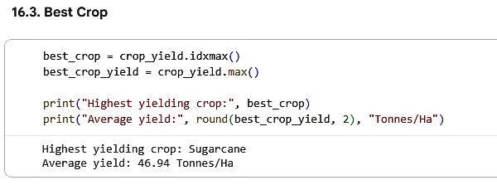
RESULTS
[ Seasonal & State-wise Yield Performance ]

Slide 7
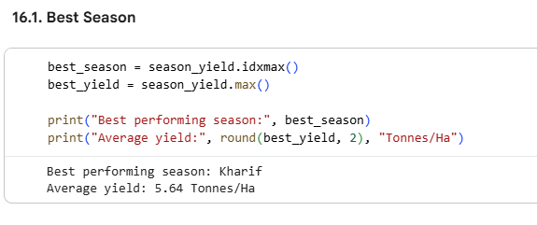
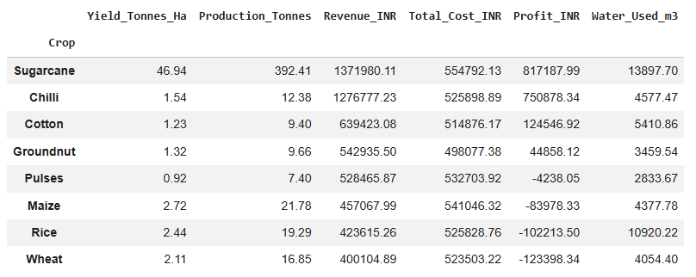
RESULTS
[ Crop Economics & Market Price Trends ]

Slide 8
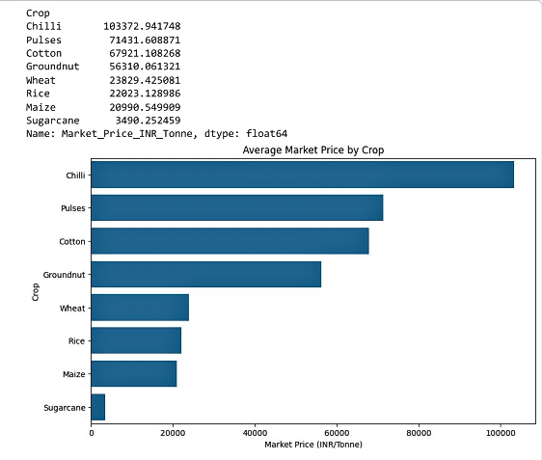
RESULTS
[ Regional Revenue & Cost Breakdown ]

Slide 9
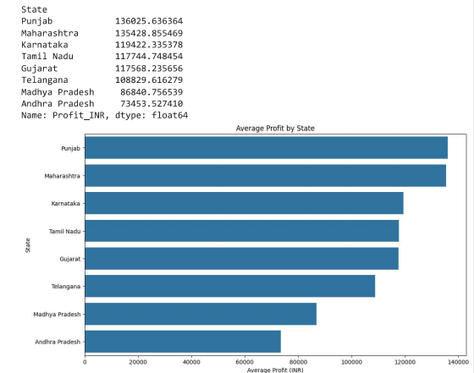
RESULTS
[ Average Profit By State ]

Slide 10
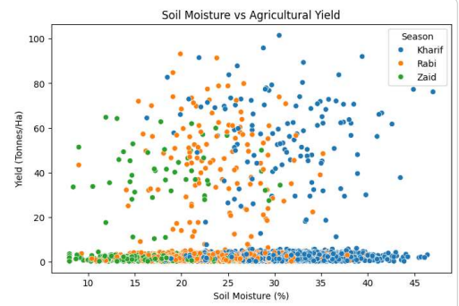
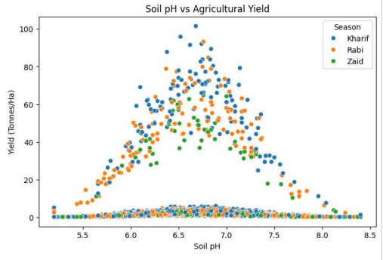
RESULTS
[ Soil pH & Moisture Impact on Yield ]
Soil Moisture vs Agricultural Yield
Soil pH vs Agricultural Yield
  Soil pH :- Optimal crop yield (up to 100 Tonnes/Ha) is achieved within a neutral pH range (6.5–7.0). Yield declines sharply when pH falls below 6.0 or exceeds 7.5.
  Soil Moisture :- Peak yield is concentrated between 20%–35% soil moisture. Moisture levels below 15% (characteristic of the Zaid season) severely restrict crop yield.

Slide 11
FUTURE SCOPE
  Machine Learning Integration :- Build predictive models (e.g., Random Forest / XGBoost) for pre-planting yield and price forecasting.
  Interactive Dashboard :- Develop a Streamlit or Power BI dashboard for real-time decision-making for farmers and extension officers.
  Real-time Weather & Sensor Data :- Integrate live IoT weather and soil moisture sensors for precision farming alerts.
  Smart Crop Recommendation Engine :- Implement AI algorithms to recommend crop rotations based on water availability and profit margins.

Slide 12
GITHUB LINK
GitHub Repository Link
[ https://github.com/Yash192004/Seasonal-Agriculture-Performance-Analysis-Project ]
Repository Contents & Deliverables :-
  Dataset (seasonal_agriculture_performance_dataset.csv) :- 4,000 raw agricultural farm records covering 28 environmental, financial, and operational variables.
  Project Statement (Project_Statement.pdf) :- Project scope, objective guidelines, problem definition, and key analytical questions.
  Colab Notebook Code (Seasonal_Agriculture_Performance_Analysis.ipynb) :- Complete Python source code for data cleaning, EDA, ANOVA hypothesis testing, and Seaborn visualizations.
  Presentation Deck (Seasonal_Agriculture_Performance_PPT.pptx) :- Major project submission PPT covering data workflow, visual results, state/season analysis, and future recommendations.
  Documentation (README.md) :- Comprehensive project documentation, execution guide, methodology summary, and core insights.

Slide 13

COURSE CERTIFICATION
  Course Name :- Data Visualization
  Issuing Authority :- VOIS / VI Foundation / Edunet Foundation

Slide 14

THANK
YOU

